Slide 1
Data Coverage and Code Coverage

Slide 2
Data Coverage
Data Coverage means At least one test case for each data item / variable / field in the program..
Data Flow
Data flow coverage involves in unit testing and integrated testing like individual module or function or several integrated modules in entire software product.

Slide 3
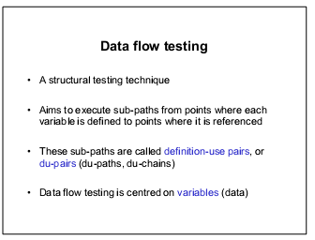

Slide 4
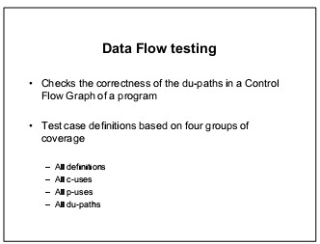

Slide 5
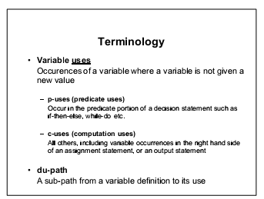

Slide 6
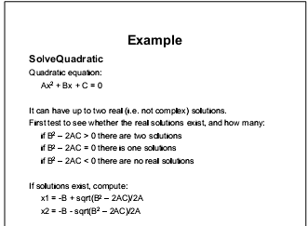

Slide 7
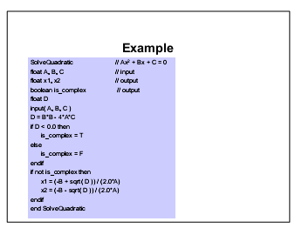

Slide 8
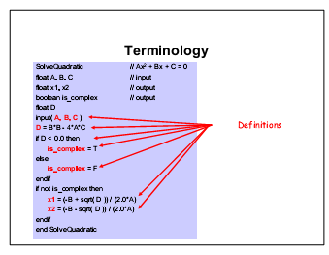

Slide 9
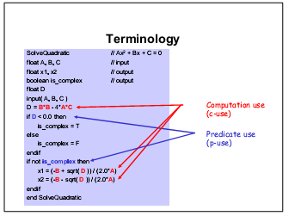

Slide 10
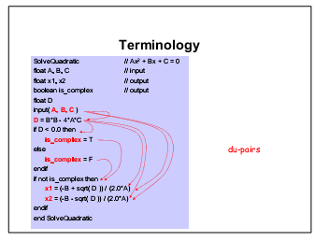

Slide 11
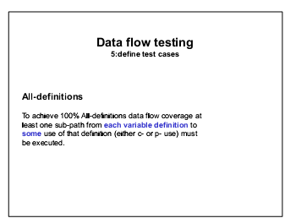

Slide 12
Code Coverage
Code coverage is dynamic white-box testing because it requires you to have full access to the code to view what parts of the software you pass through when you run your test cases

Slide 13
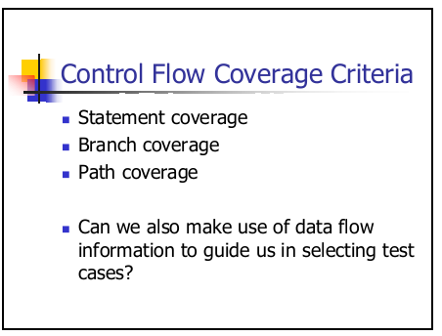

Slide 14
Program Statement and Line Coverage
The most straightforward form of code coverage is called statement coverage or line coverage.
If you’re monitoring statement coverage while you test your software, your goal is to make sure that you execute every statement in the program at least once.
In the case of the short pro-gram shown in Listing 7.1, 100 percent statement coverage would be the execution of lines 1 through 4.

Slide 15


Slide 16
Branch Coverage
Attempting to cover all the paths in the software is called path testing.
The simplest form of path testing is called branch coverage testing. Consider the program shown in Listing 7.2.

Slide 17

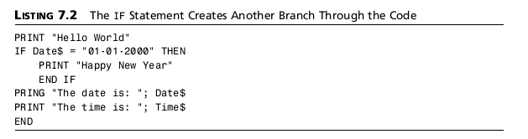

Slide 18
Condition Coverage
Just when you thought you had it all figured out, there’s yet another complication to path test-ing. Listing 7.3 shows a slight variation to Listing 7.2. An extra condition is added to the IF statement in line 2 that checks the time as well as the date.
Condition coverage testing takes the extra conditions on the branch statements into account.

Slide 19
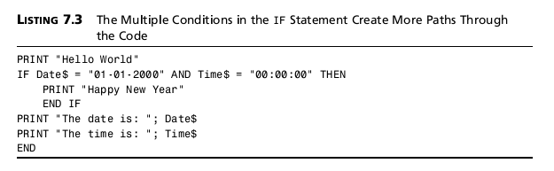

Slide 20
In this sample program, to have full condition coverage testing, you need to have the four sets of test cases shown in Table 7.2. These cases assure that each possibility in the Ifstatement are covered

Slide 21
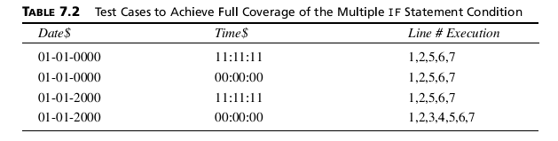

Slide 22
If you were concerned only with branch coverage, the first three conditions would be redun-dant and could be equivalence partitioned into a single test case.
But, with condition coverage testing, all four cases are important because they exercise different conditions of the IFstate-ment in line 4.

Slide 23
As with branch coverage, code coverage analyzers can be configured to consider conditions when reporting their results.
If you test for all the possible conditions, you will achieve branch coverage and therefore achieve statement coverage.

Slide 24
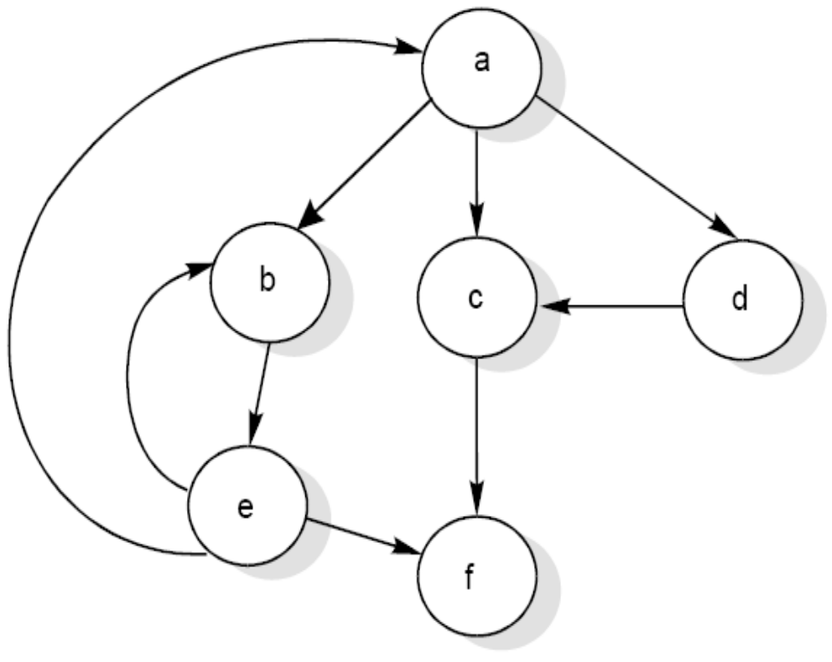
Software Testing
Cyclomatic Complexity
McCabe’s cyclomatic metric V(G) = e – n + 2P.
For example, a flow graph shown in in Fig. 21 with entry node ‘a’ and exit node ‘f’.
Fig. 21: Flow graph

Slide 25
Software Testing
The value of cyclomatic complexity can be calculated as :
V(G) = 9 – 6 + 2 = 5
Here e = 9, n = 6 and P =1

Slide 26

Software Testing
Two alternate methods are available for the complexity calculations.
Cyclomatic complexity V(G) of a flow graph G is equal to the number of predicate (decision) nodes plus one.
V(G)= +1
Where is the number of predicate nodes contained in the flow graph G.
Cyclomatic complexity is equal to the number of regions of the flow graph.

Slide 27
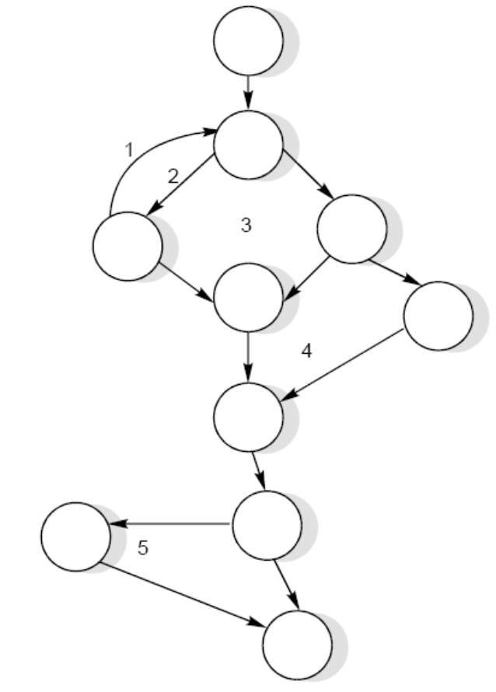
Software Testing
Example 8.15
Consider a flow graph given in Fig. 23 and calculate the cyclomatic complexity by all three methods.
Fig. 23

Slide 28
Software Testing
Solution
Cyclomatic complexity can be calculated by any of the three methods.
V(G) = e – n + 2P
  = 13 – 10 + 2 = 5
2. V(G) = π + 1
  = 4 + 1 = 5
Therefore, complexity value of a flow graph in Fig. 23 is 5.

Slide 29
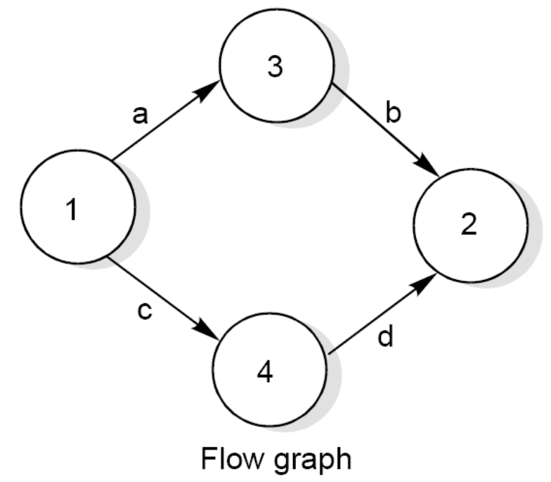
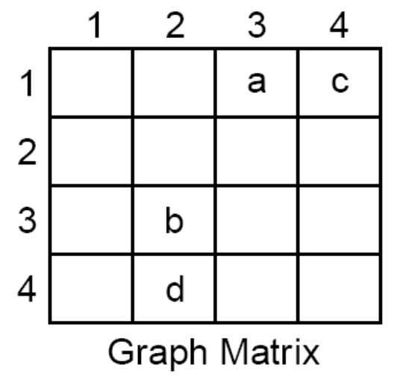


Software Testing
Graph Matrices
A graph matrix is a square matrix with one row and one column for every node in the graph. The size of the matrix (i.e., the number of rows and columns) is equal to the number of nodes in the flow graph. Some examples of graphs and associated matrices are shown in fig. 24.
Fig. 24 (a): Flow graph and graph matrices

Slide 30
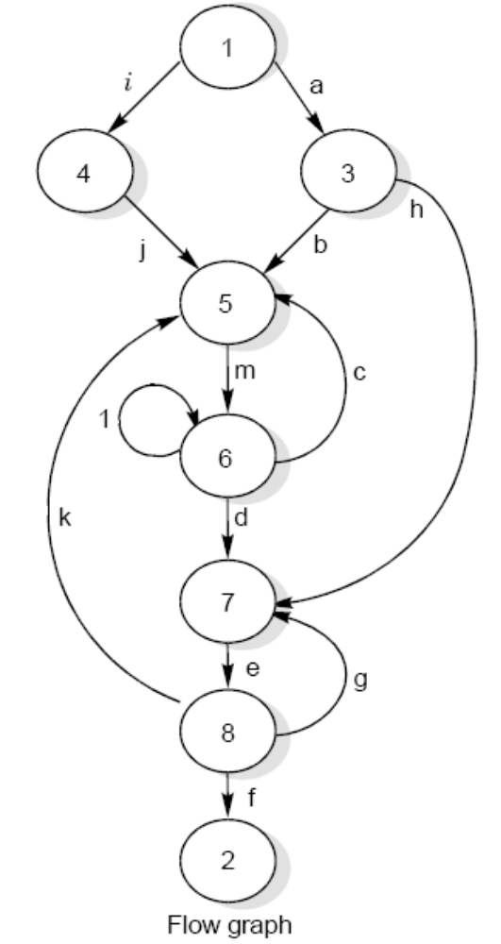
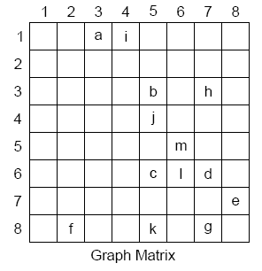

Software Testing
Fig. 24 (c): Flow graph and graph matrices

Slide 31
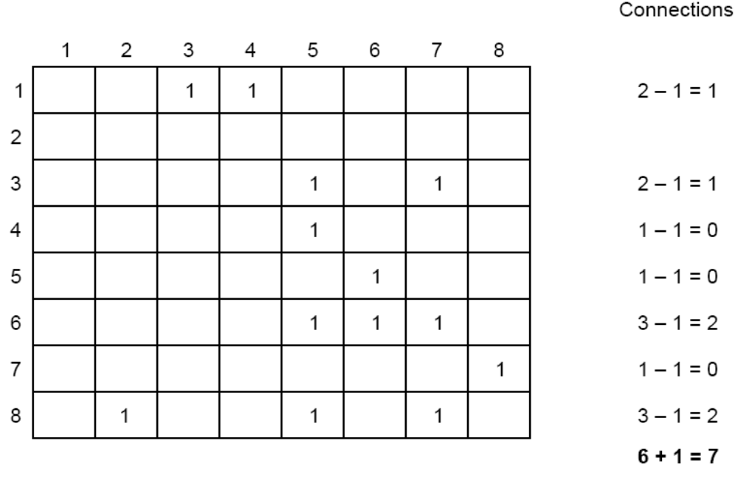
Software Testing
Fig. 25 : Connection matrix of flow graph shown in Fig. 24 (c)

Slide 32
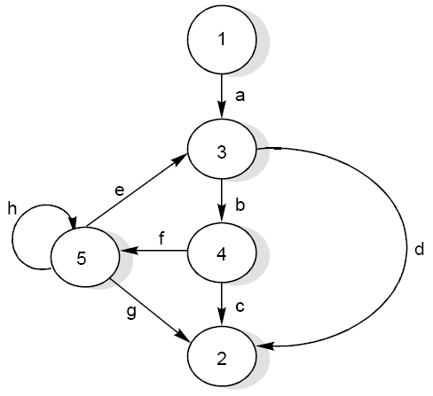
Software Testing
Example 8.19
Consider the flow graph shown in the Fig. 26 and draw the graph & connection matrices. Find out cyclomatic complexity and two / three link paths from a node to any other node.
Fig. 26 : Flow graph

Slide 33
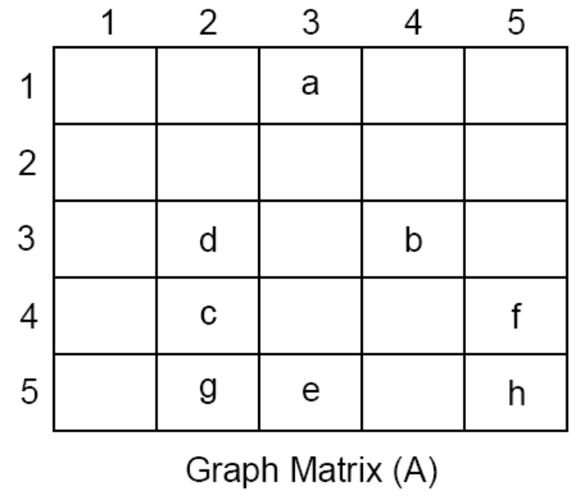
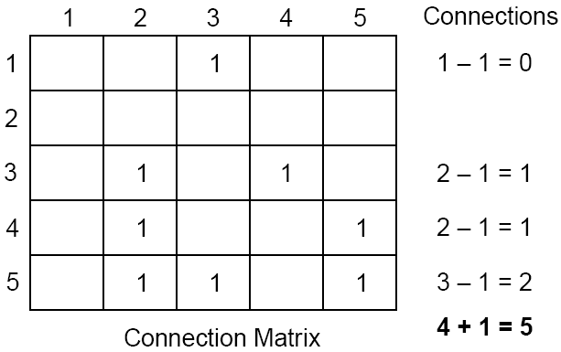
Software Testing
Solution
The graph & connection matrices are given below :
To find two link paths, we have to generate a square of graph matrix [A] and for three link paths, a cube of matrix [A] is required.

